Slide 1
Potato Chip Mailing Contest
Group 5
AKA Group $vvaga1ici0u5
I didn’t vote on this

Slide 2
Objective/Requirements
Build something that will protect a potato chip as it is mailed.

Slide 3
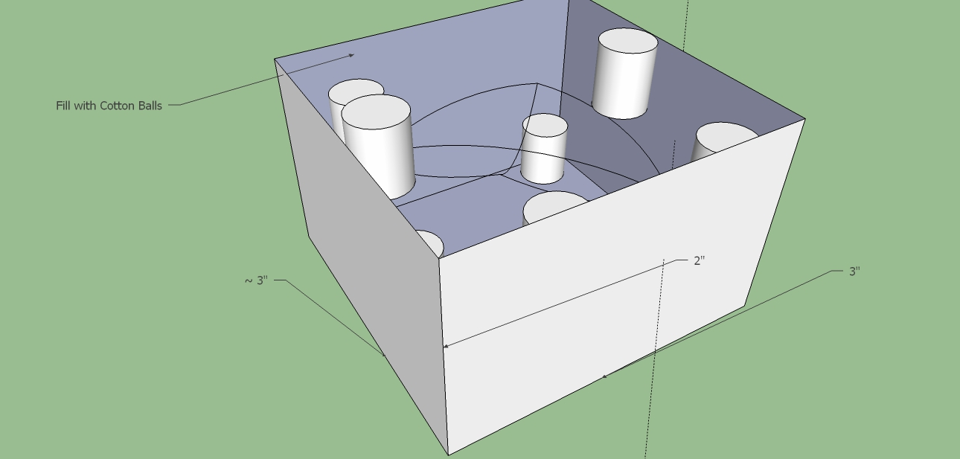
Design

Slide 4
Predicted Score with Explanation
Idk they just told me to write 100
We predict to score 100 points. This is because apparently this is a great idea. Also stale chips don’t break easily

Slide 5
Parts List
Cardboard
Cotton Balls
Tape for box closing

Slide 6
Photo of Mailed Container

Slide 7
Data
Official Score

Slide 8
Lessons Learned
What worked well
What would you change next time
If your predicted score differed from your actual, why?

